Slide 1


Slide 2
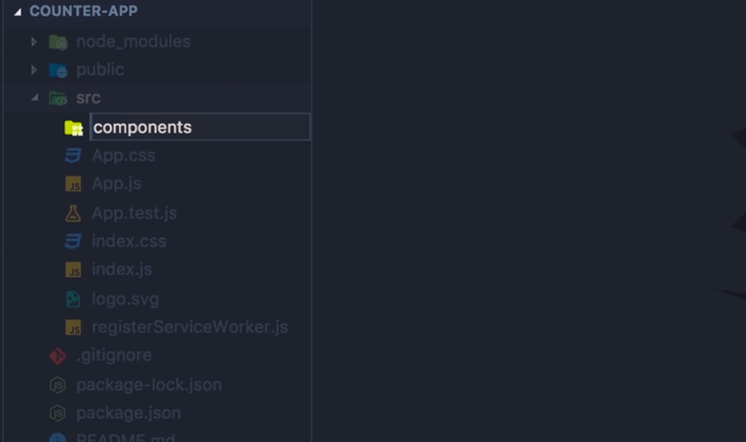

Slide 3
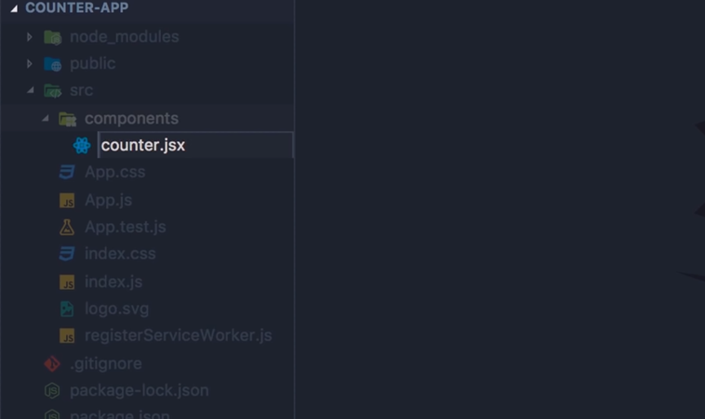

Slide 4
create our first component
in the source folder let's add a new folder components by convention we put all our components here
the components folder let's add a new file we call it counter.JSX
note that here I'm using camel notation so the first letter of the first word should be lowercase and the first letter of every word after should be uppercase
so if you wanted to call this file counter component you would name it like this counterComponent with a capital C
use the JSX extension instead of just js because with this you would get better code completion

Slide 5
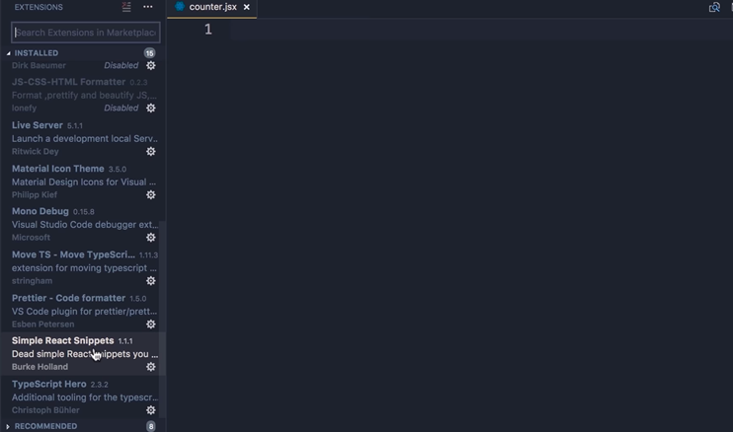

Slide 6
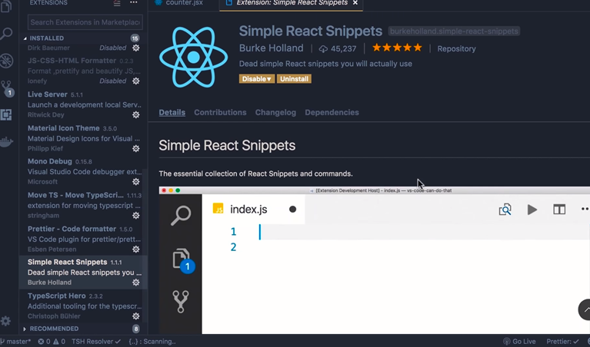

Slide 7
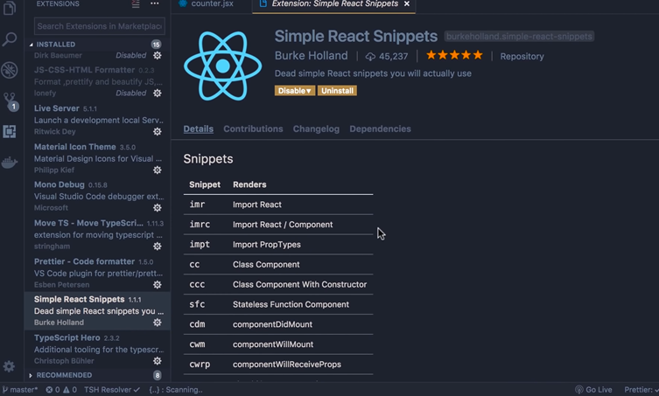

Slide 8
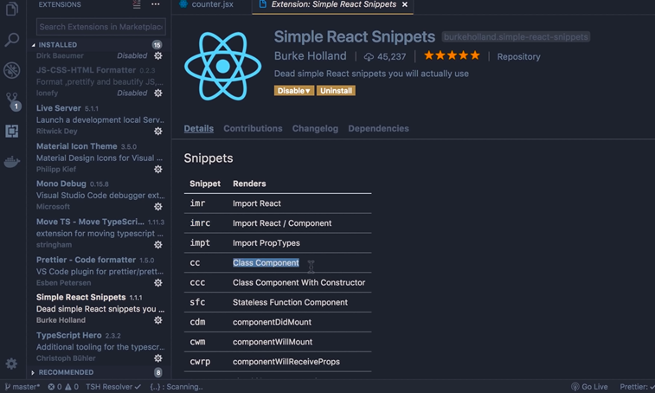

Slide 9
so here's our counter module in this module on the top we need to import react and the component class from the react module we can manually type it by hand or You have a shortcut to generate this line.
Earlier in the previous session we installed an extension called simple react snippet ,so here on the extensions tab under installed you can see simple react snippets this is a very powerful extension it has a lot of shortcuts to quickly generate code you can find all the shortcuts below
couple of these shortcuts one is IMRC for generating the import statement and the other is CC for generating a class component

Slide 10
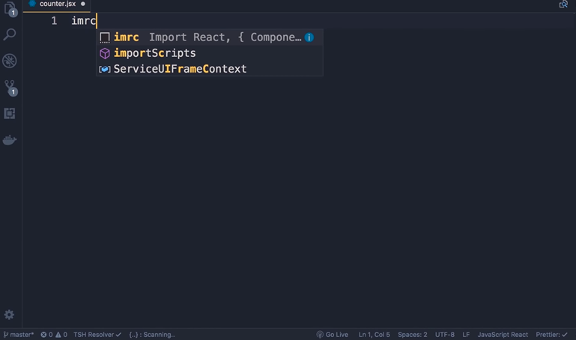

Slide 11
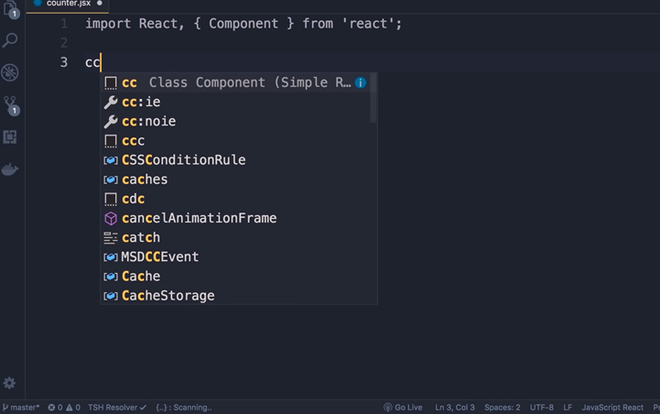

Slide 14
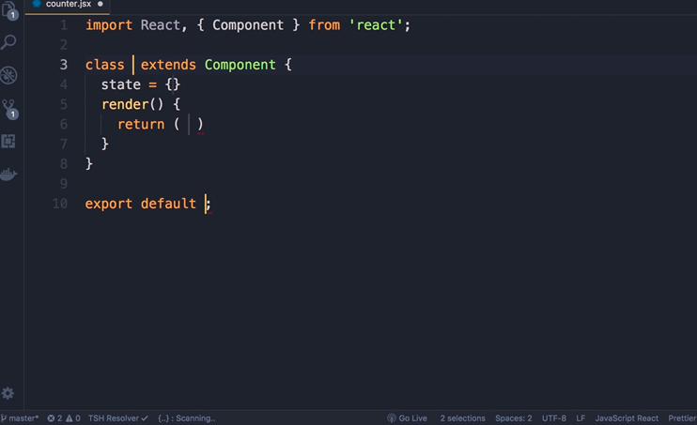

Slide 15
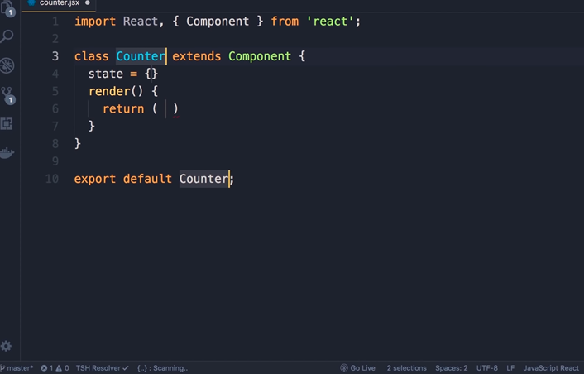

Slide 16
so I can counter.JSX type IM RC which is short for import react component and press tab done next type CC which is short for create class
now here we have multiple cursors so what we type is reflected in both places
Give this component a name so counter with a capital C now to stop Multi cursor editing press the escape button so we have

Slide 17
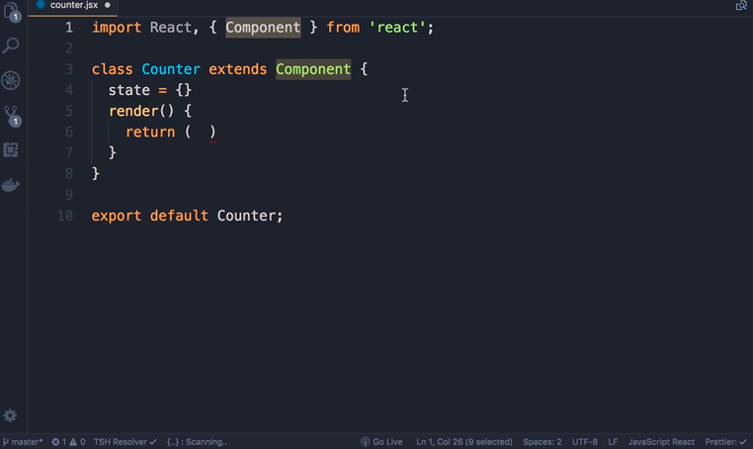

Slide 18
counter class that extends the component class that we imported on the top from the react module this component class has a bunch of methods that we're going to inherit in this counter class
This code also generates the state property in this session we are not working with state so delete it

Slide 19
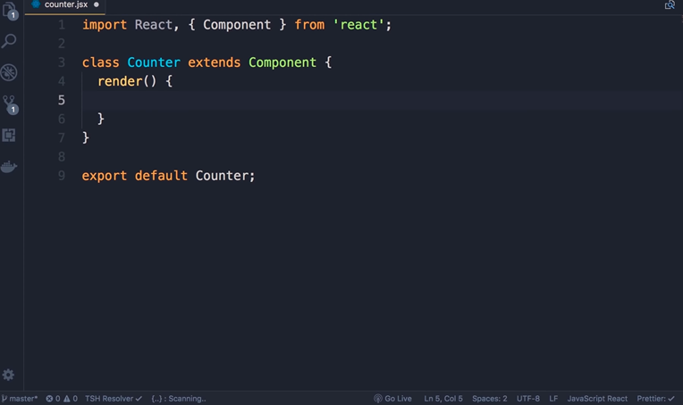

Slide 20
Modify the render method to return a simple h1 with the text hello world
now to refresh your memory what we have here is a JSX expression it's not a string's a JSX expression which eventually gets compiled to calls to Reacte.createElement that's why we have to import the react object on the top
even though we're not going to directly use this in our code
note that in this generated code we are defining the class here and then exporting it separately on line 9

Slide 21
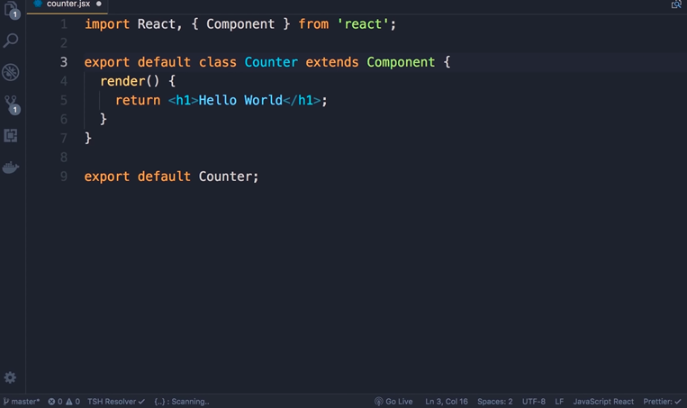

Slide 22
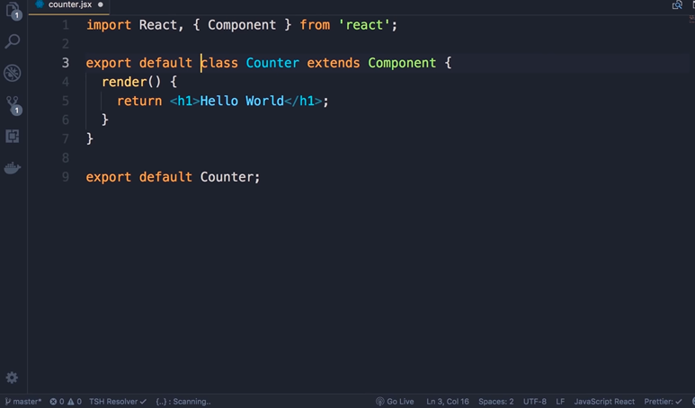

Slide 23
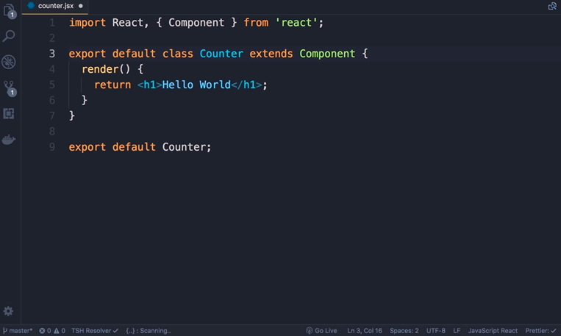

Slide 24
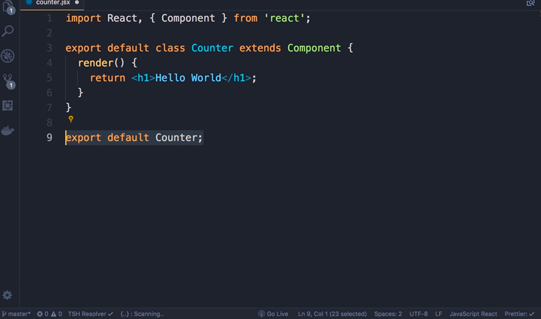

Slide 25
In previous session we define a class and exported it on the same line
so here we can do something like this export default class counter and then we can delete what we have on line 9

Slide 26
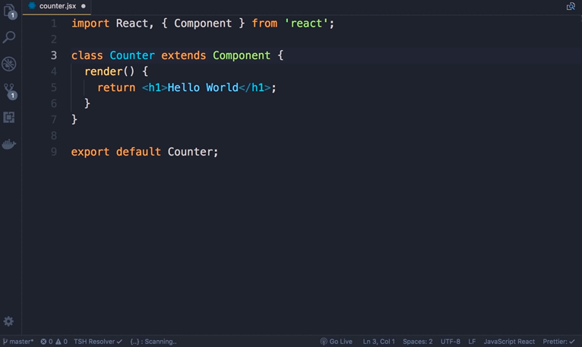

Slide 27
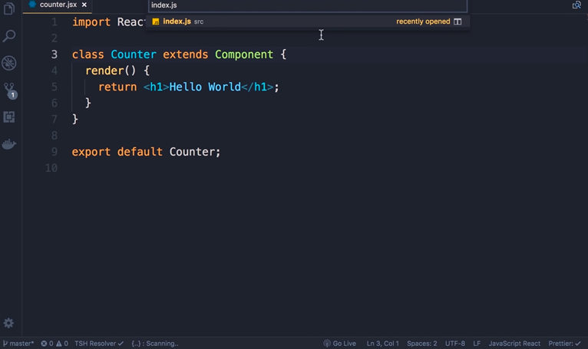

Slide 28
Let’s just use the template that is generated by this extension so I don't have to modify it every time ,let's revert this back
save the changes we need to go to index.js
so on the pallete type index.js

Slide 29
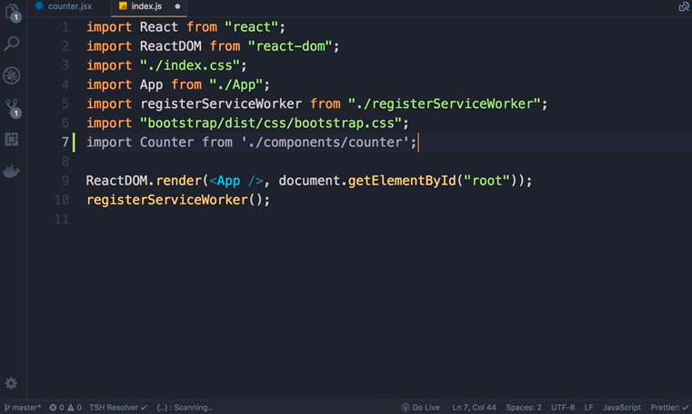

Slide 30
Index.js here we need to import counter class
so import counter from period slash components slash counter I note that because counter is a default export we don't need curly braces around it

Slide 31
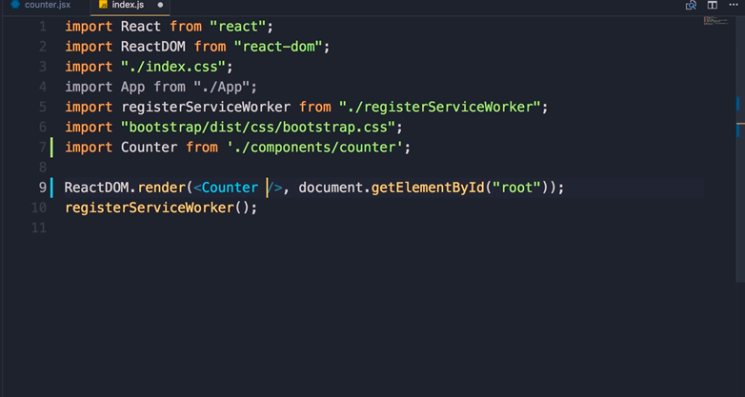

Slide 32
finally on line nine where you're rendering a react component instead of the app component we're gonna render our counter component so you can see with this components

Slide 33
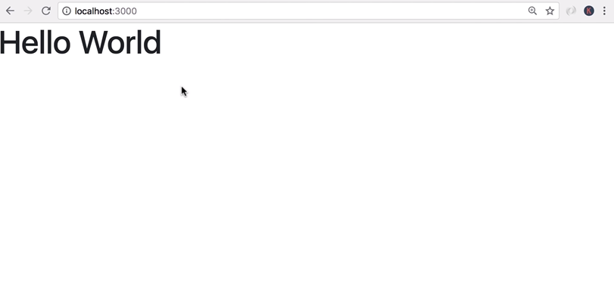

Slide 34
we are extending the HTML vocabulary so wherever we have a counter element will get the output of the counter component which is determined by what is returned from the render method now back in the browser we can see our counter component rendered in the DOM

